Slide 1
ME16A: CHAPTER FIVE
DEFLECTION OF BEAMS

Slide 2
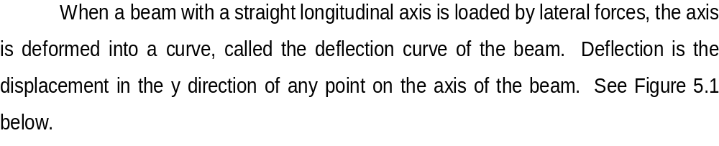
CHAPTER FIVE - DEFLECTION OF BEAMS
P
A
v
y
A
x
B

Slide 3
Deflection of Beams Contd.
The calculation of deflections is an important part of structural analysis and design.
Deflections are essential for example in the analysis of statically indeterminate structures and in dynamic analysis, as when investigating the vibration of aircraft or response of buildings to earthquakes.
Deflections are sometimes calculated in order to verify that they are within tolerable limits.

Slide 4
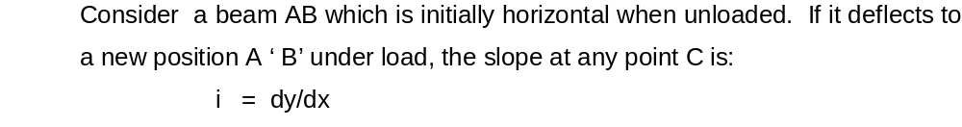
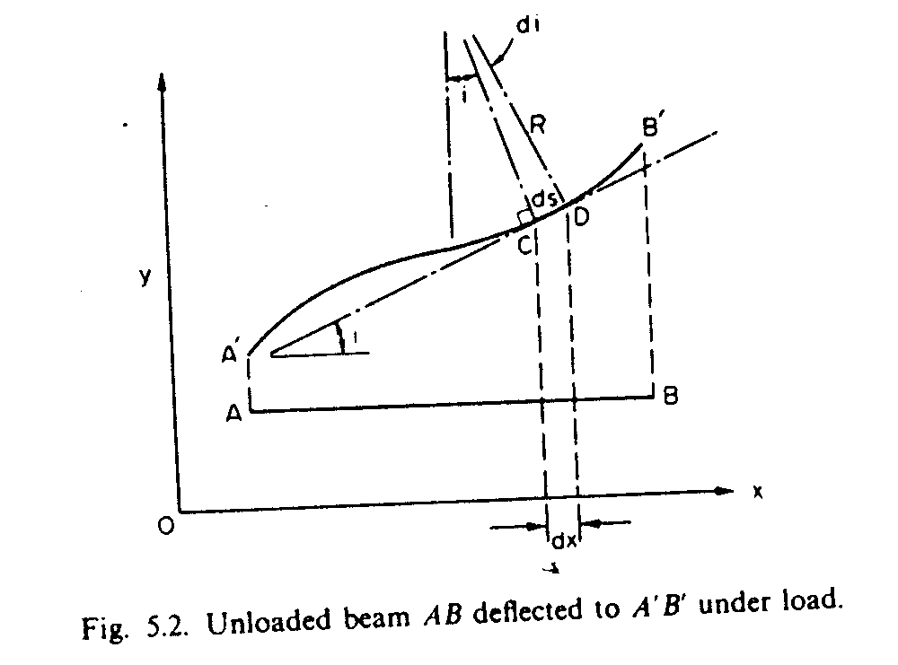
5.1 RELATIONSHIP BETWEEN LOADING, SHEAR FORCE, BENDING MOMENT, SLOPE AND DEFLECTION.

Slide 5
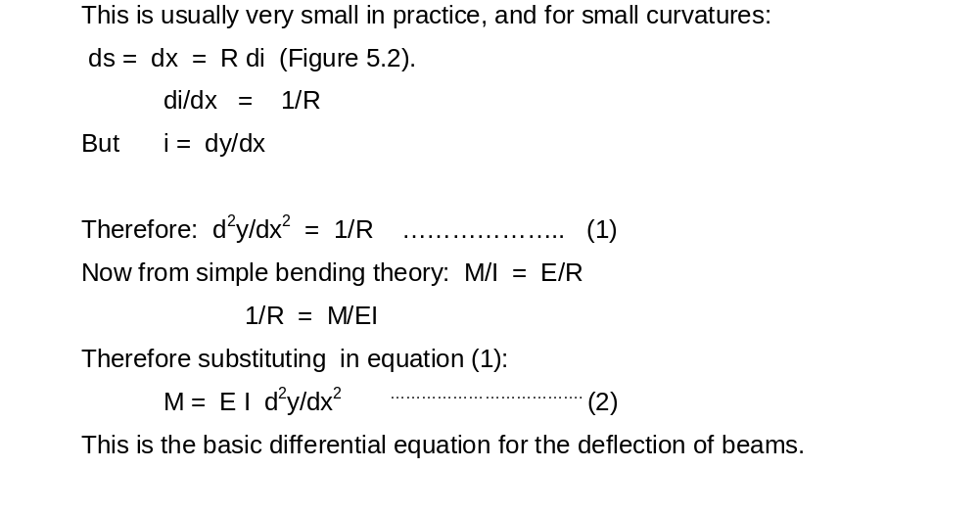
Basic Differential Equation For Deflection

Slide 6
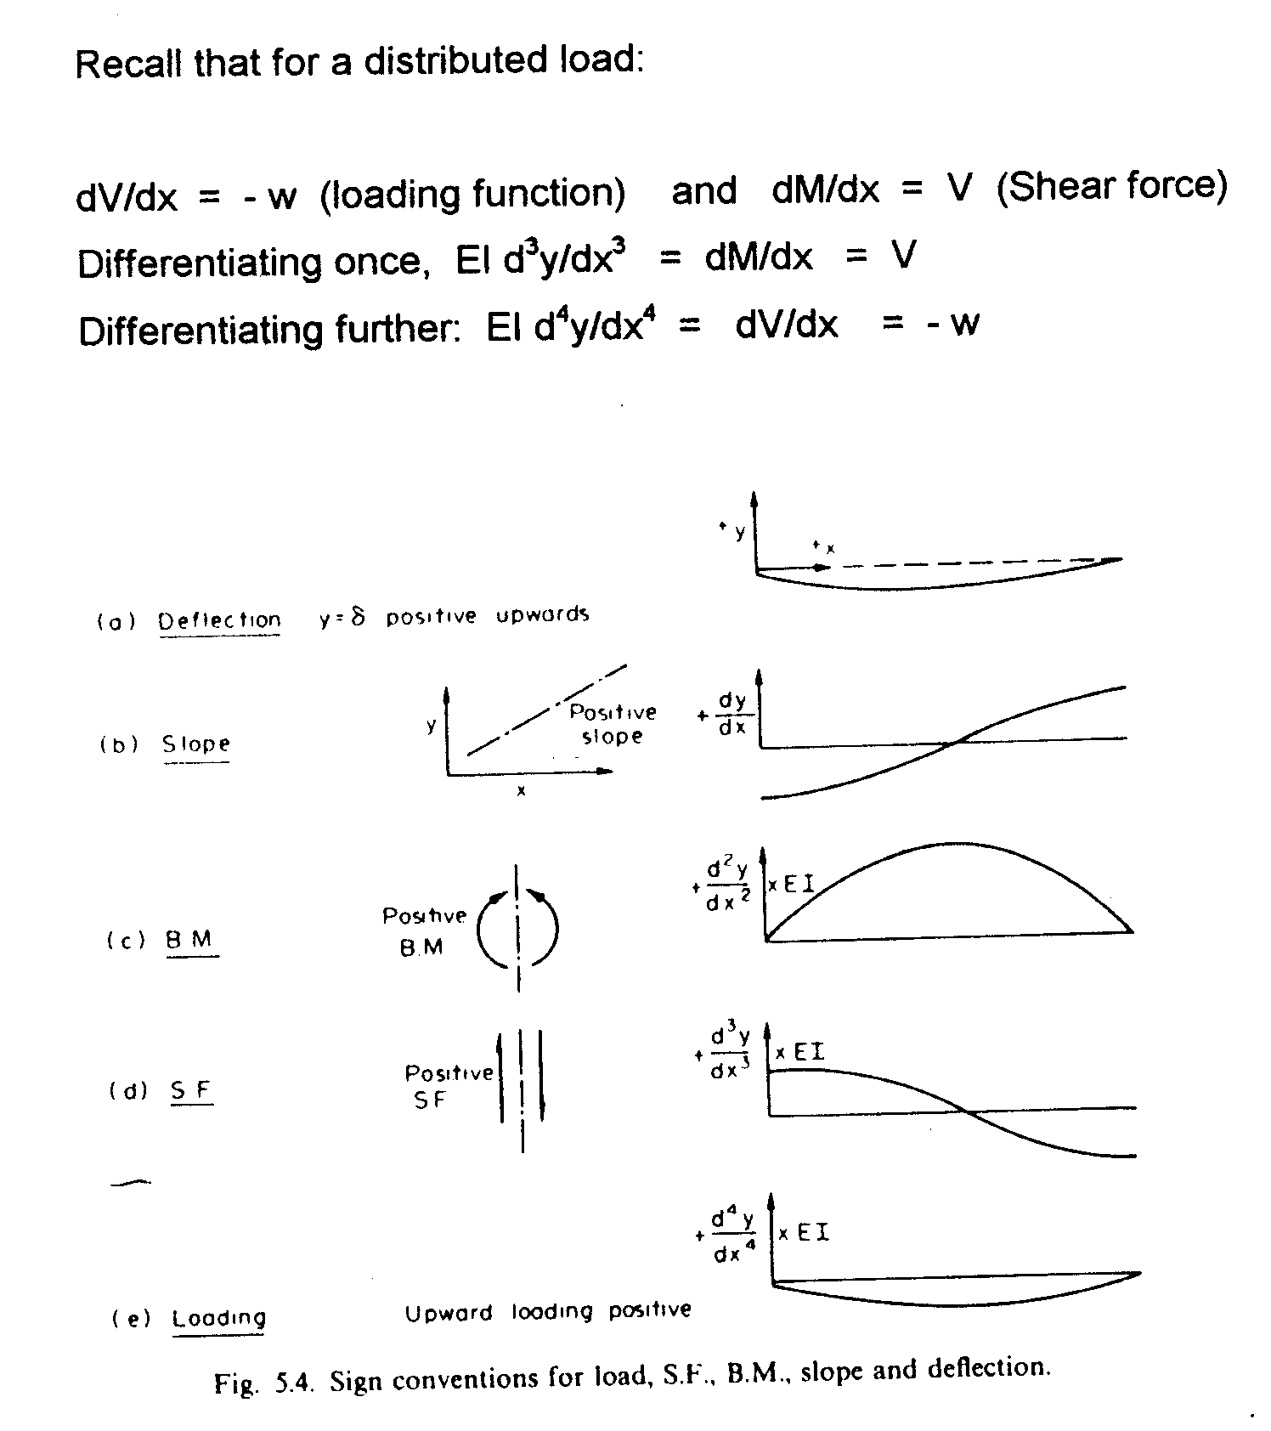

Slide 7
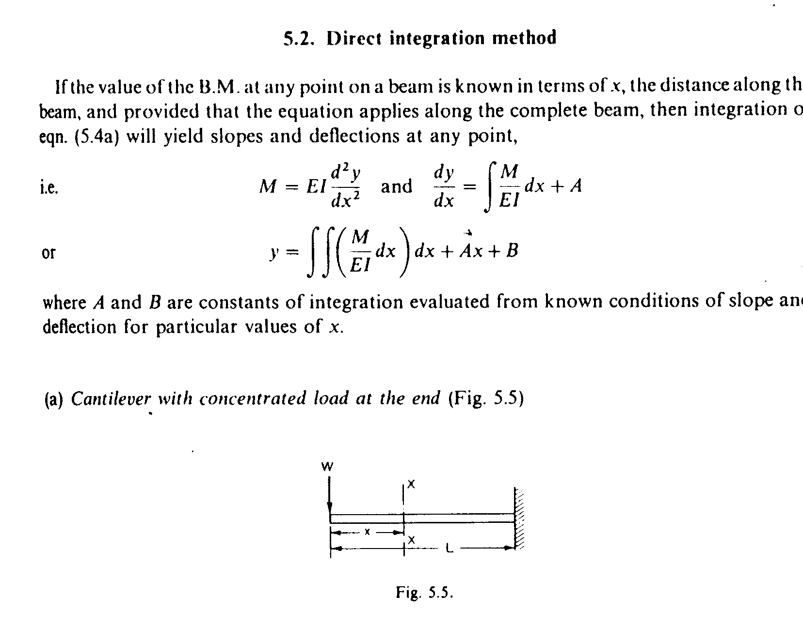
Direct Integration Method

Slide 8
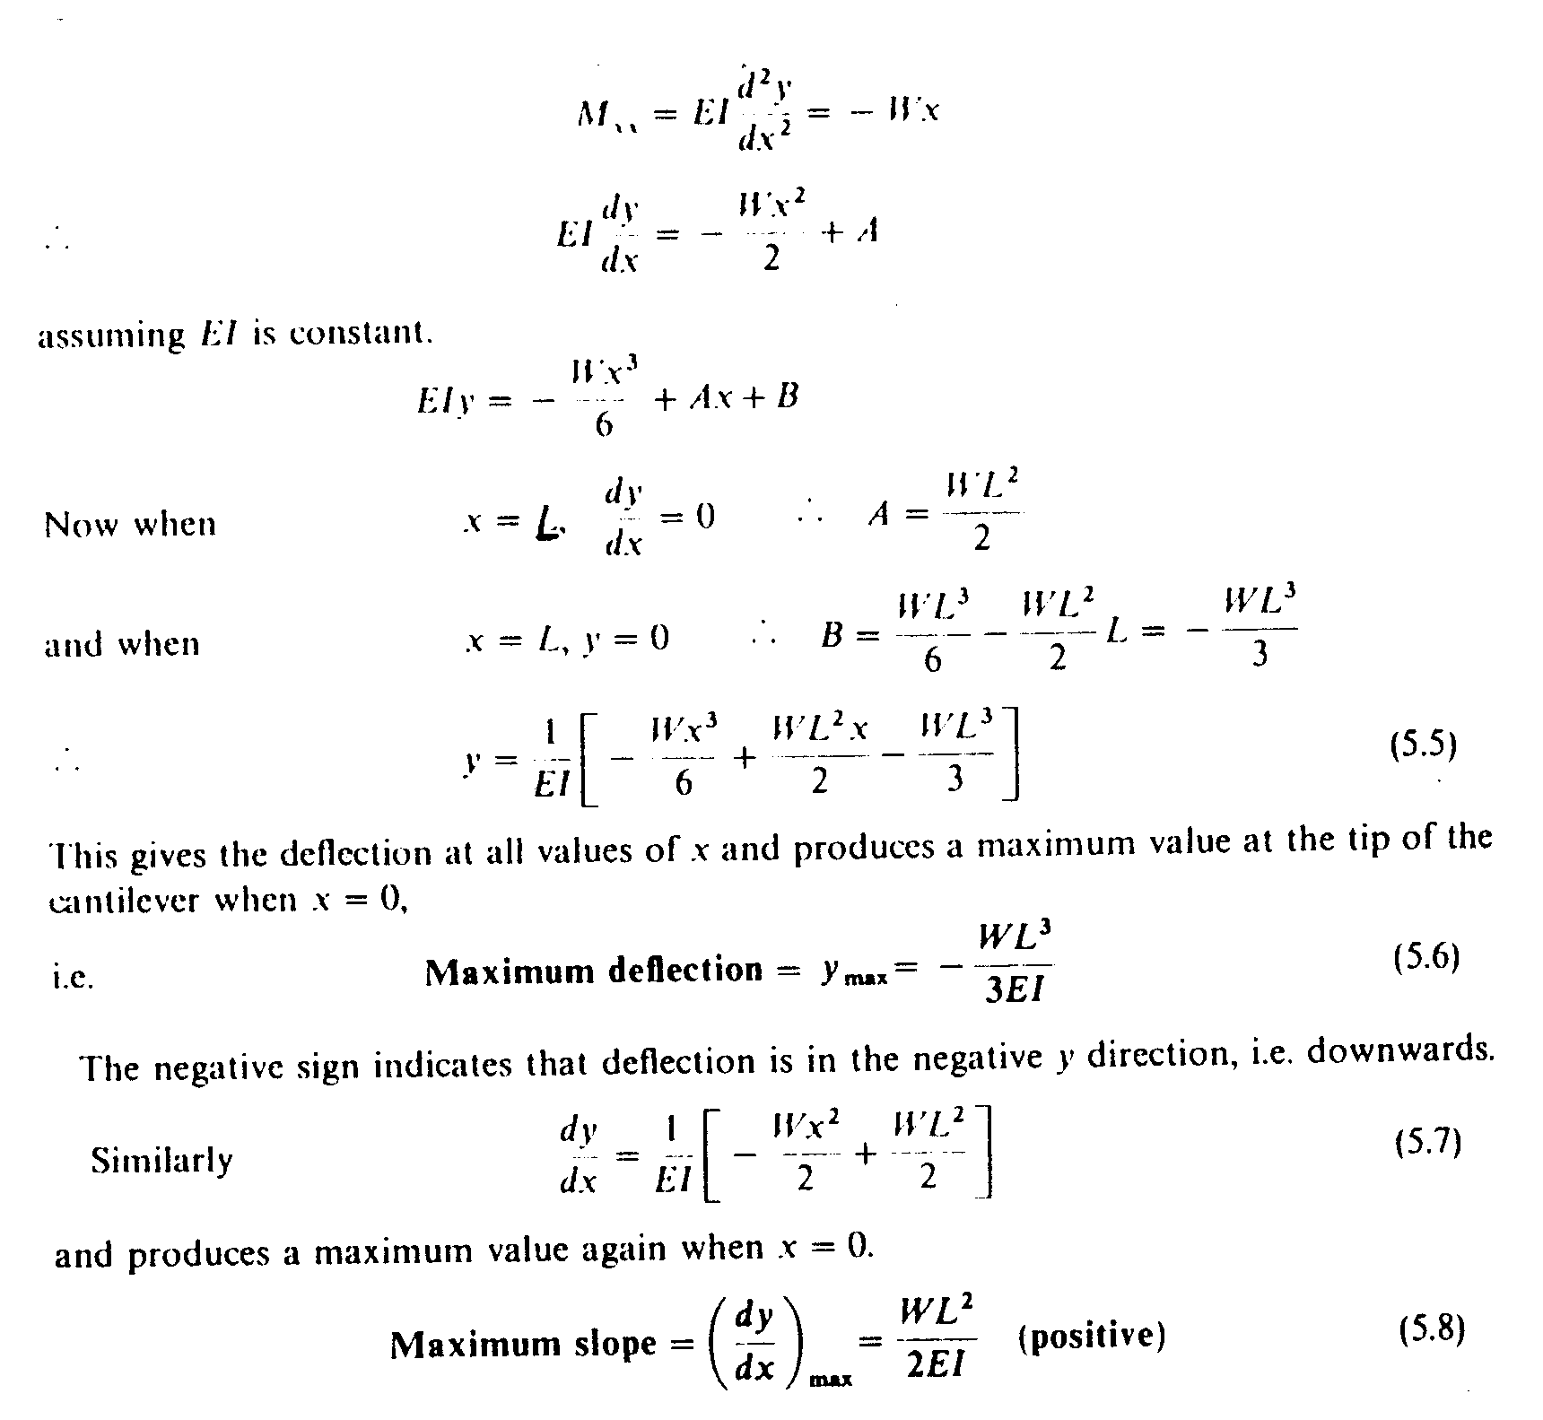

Slide 9
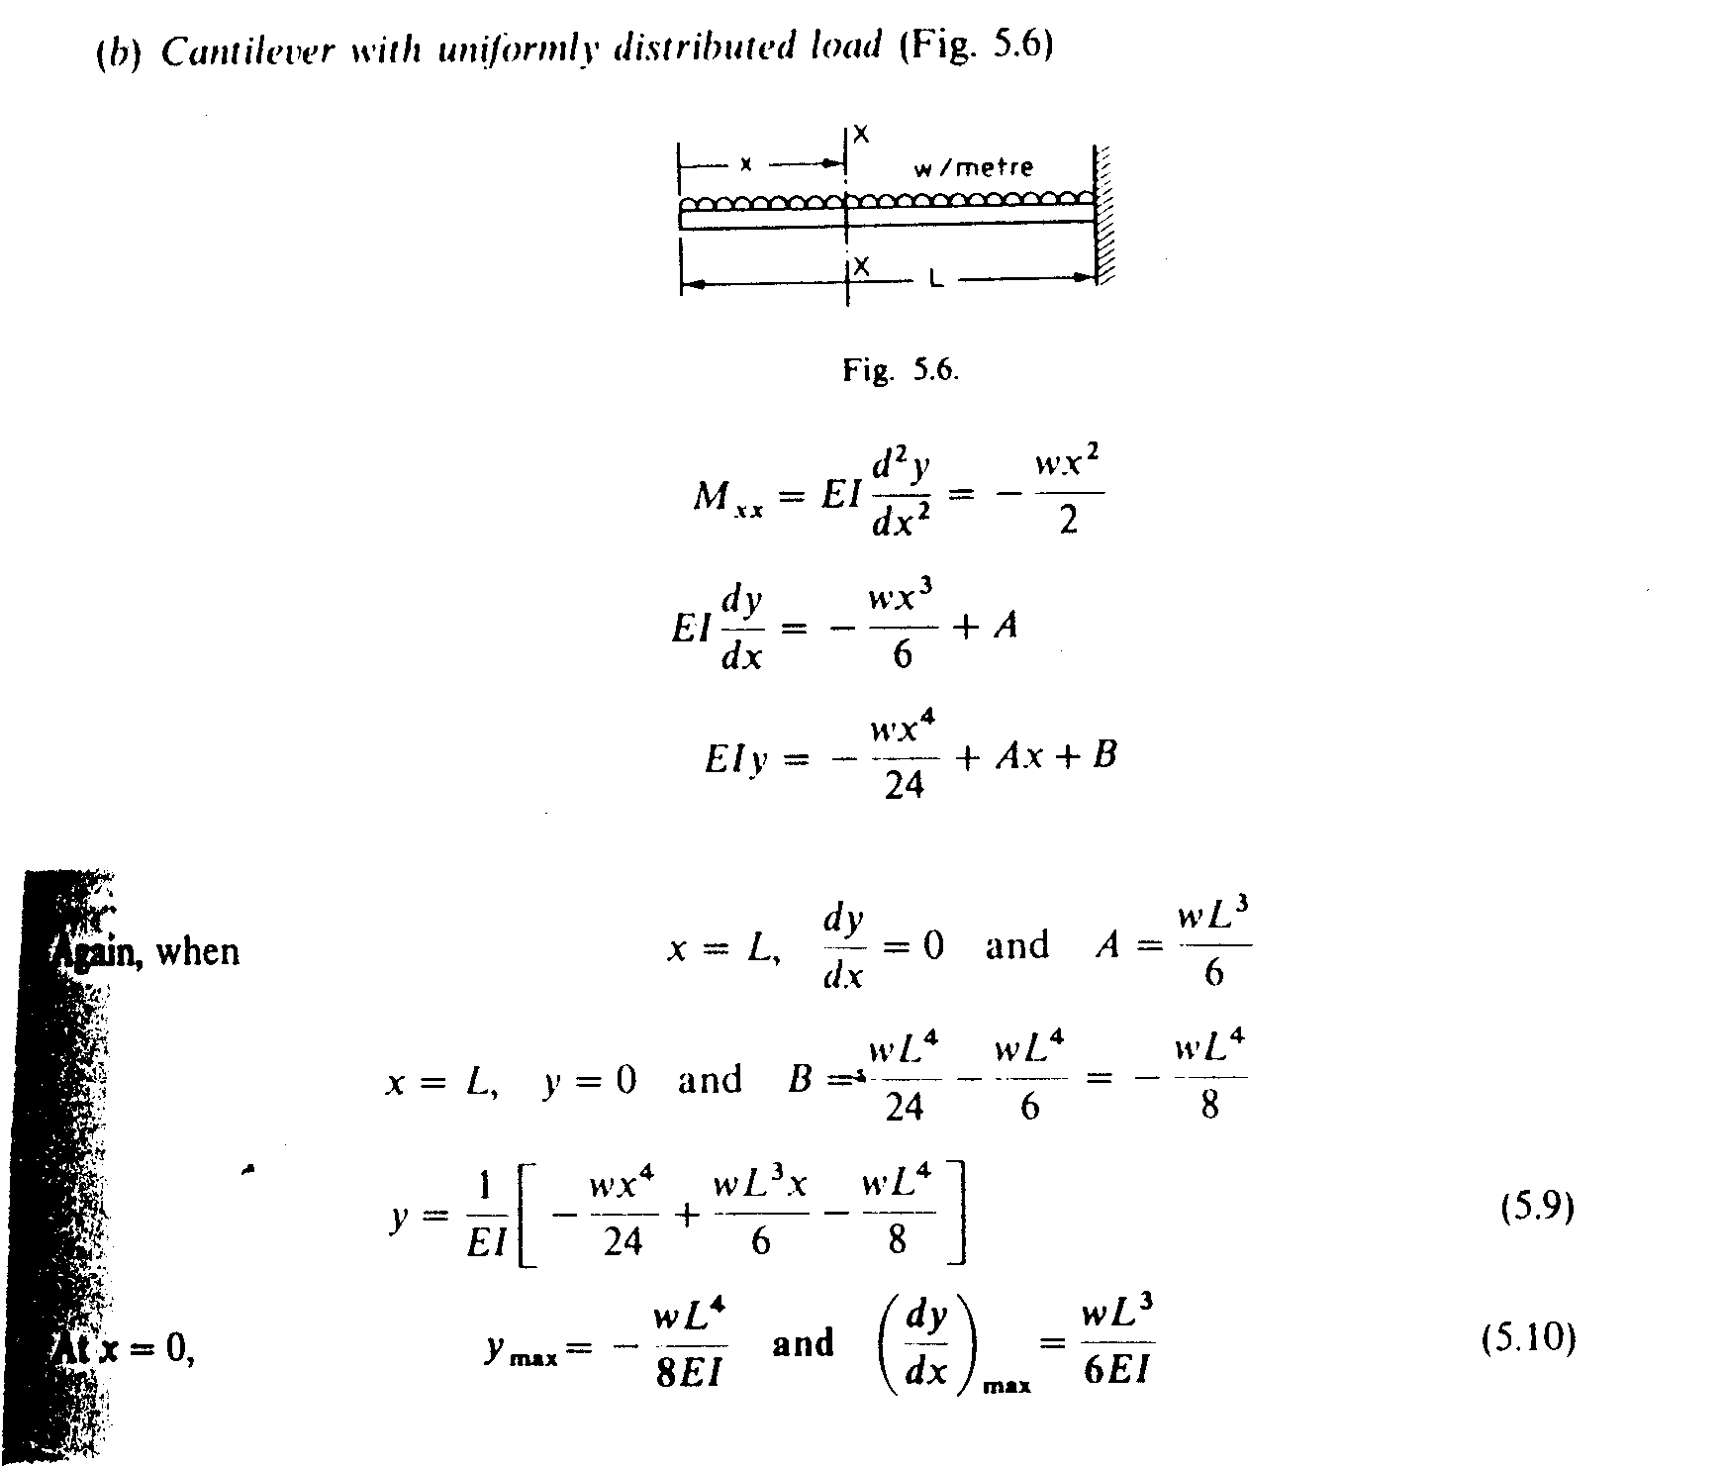

Slide 10
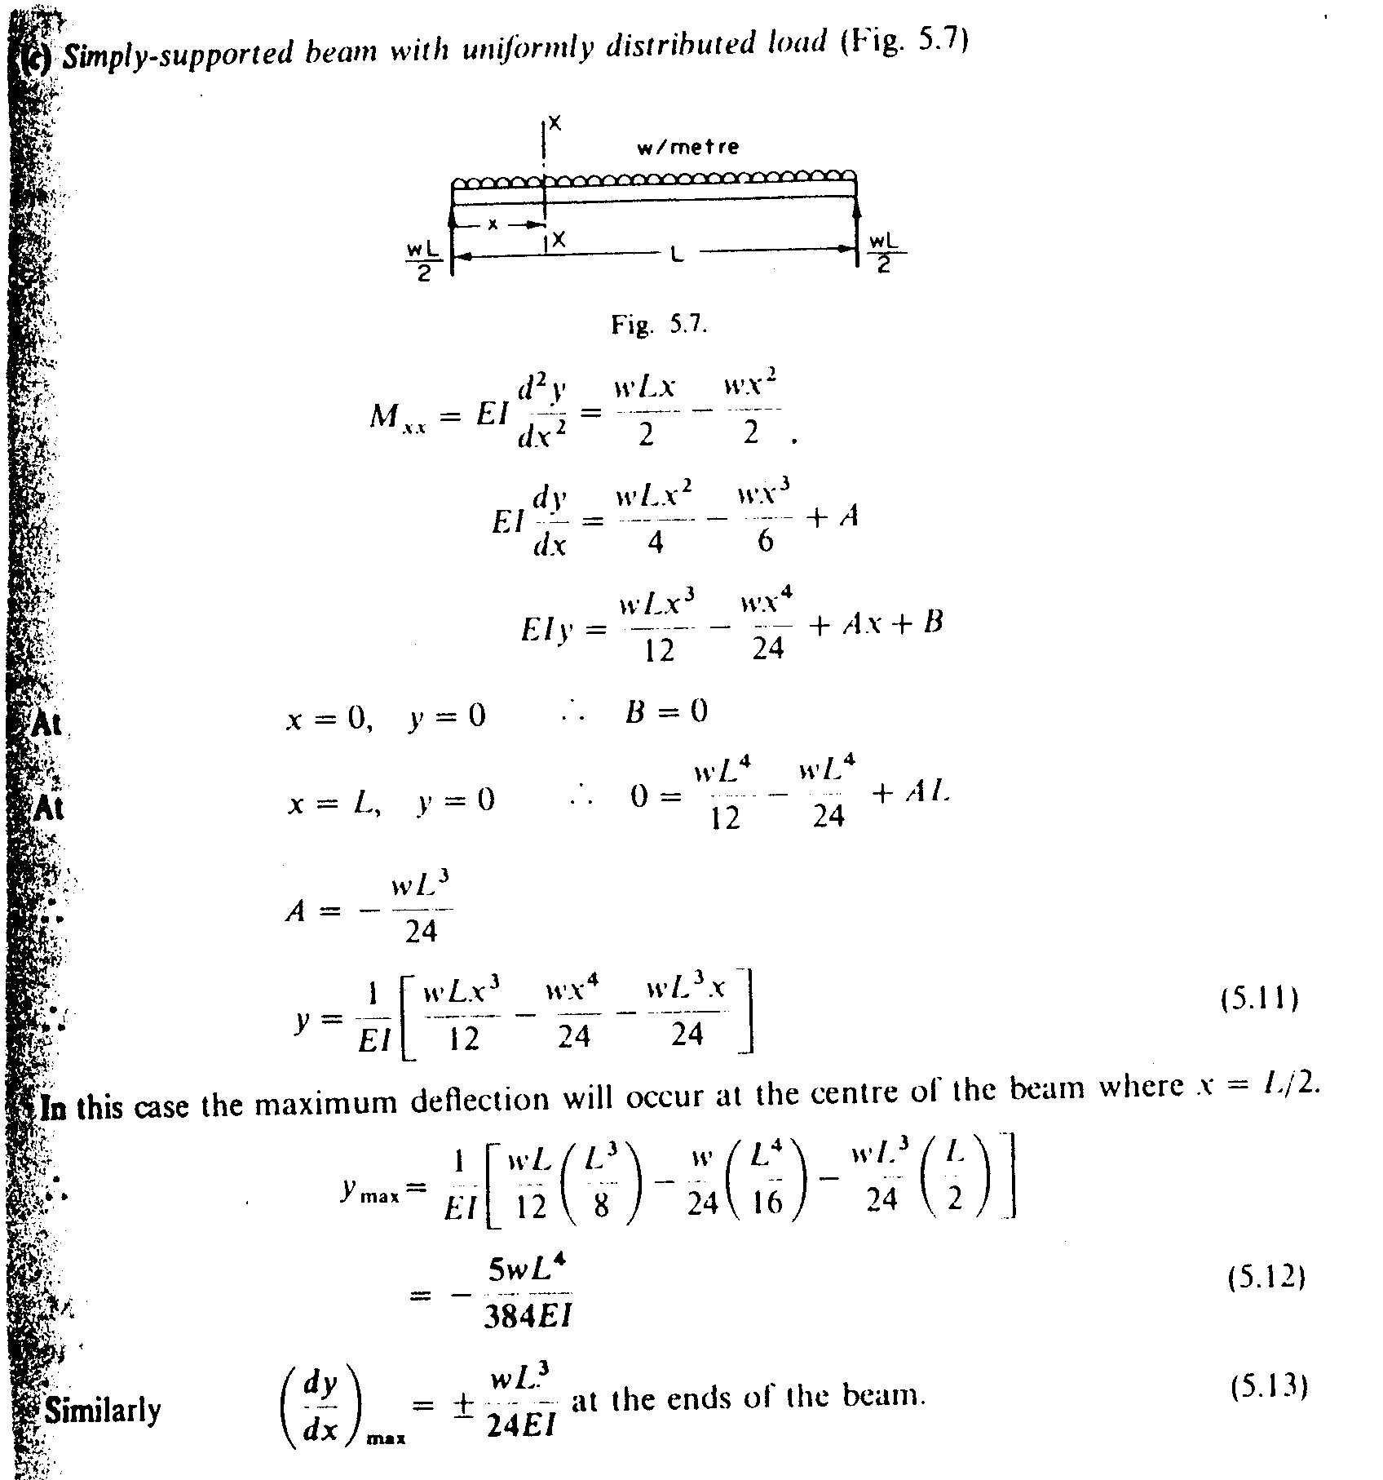

Slide 11
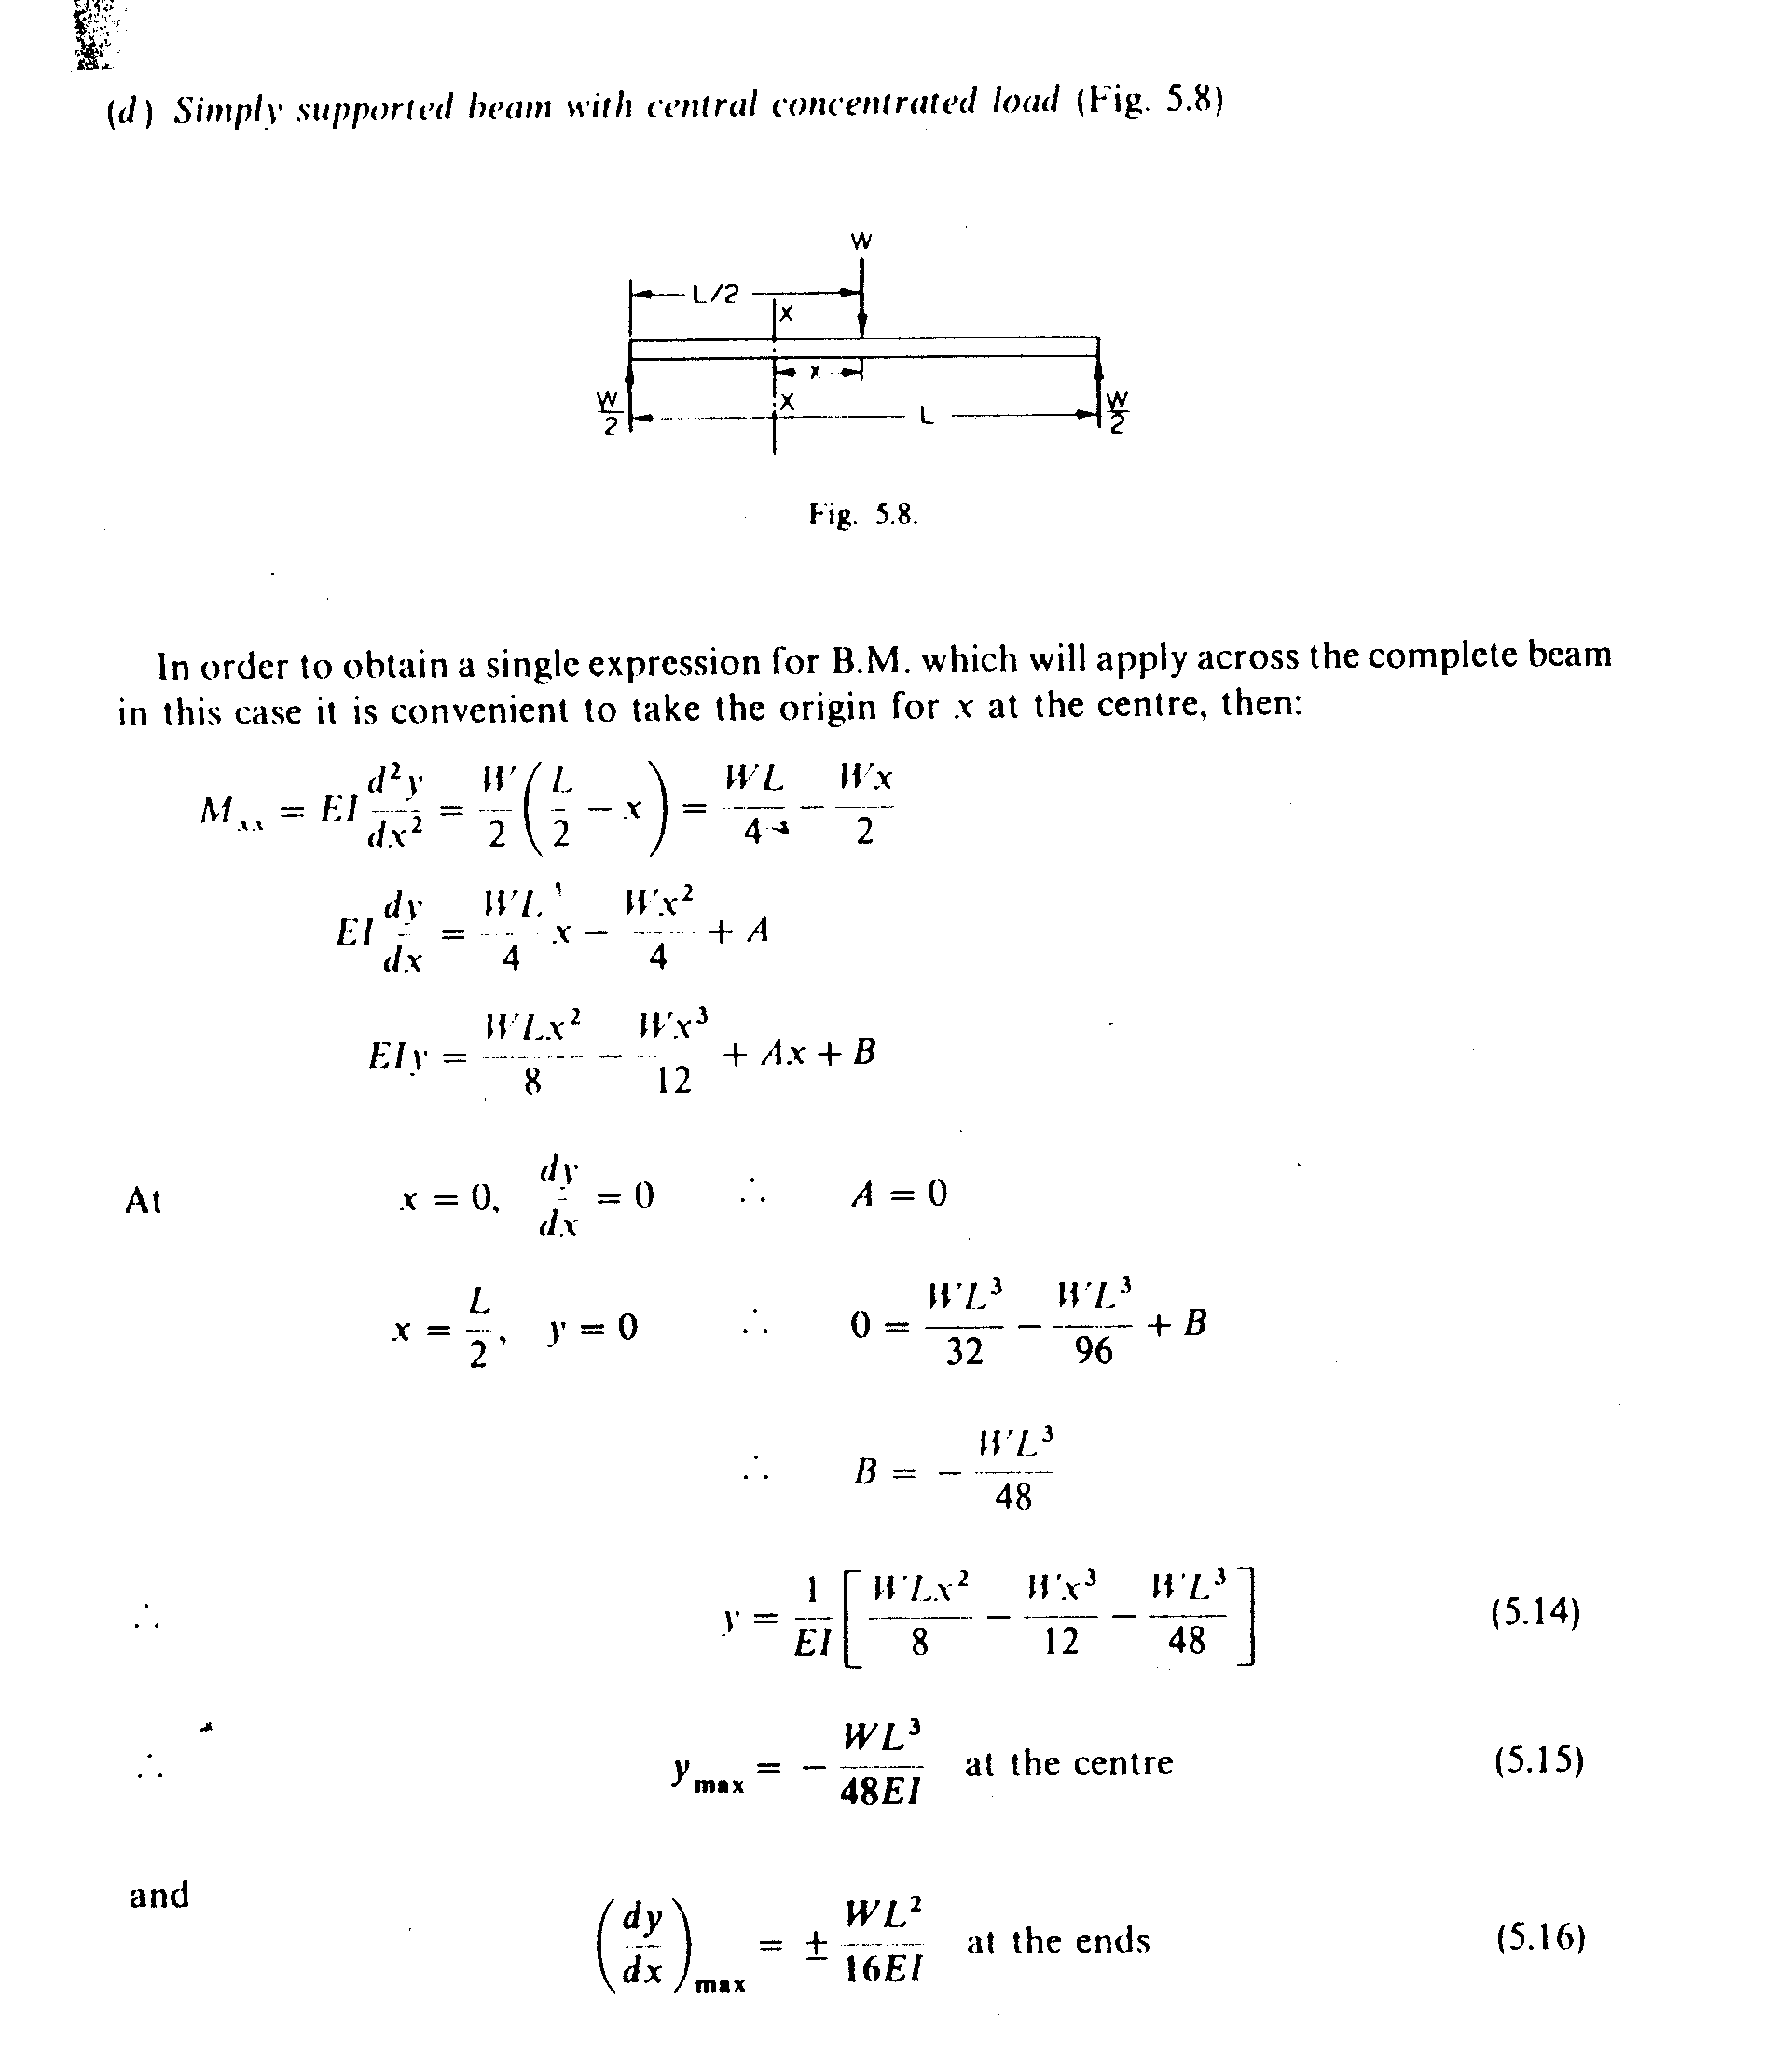

Slide 12
Direct Integration Method Contd.
In Some cases, it is not convenient to commence the integration procedure with the bending moment equation since this may be difficult to obtain. In such cases, it is often more convenient to commence with the equation for the loading at the general point XX of the beam. A typical example follows:

Slide 13
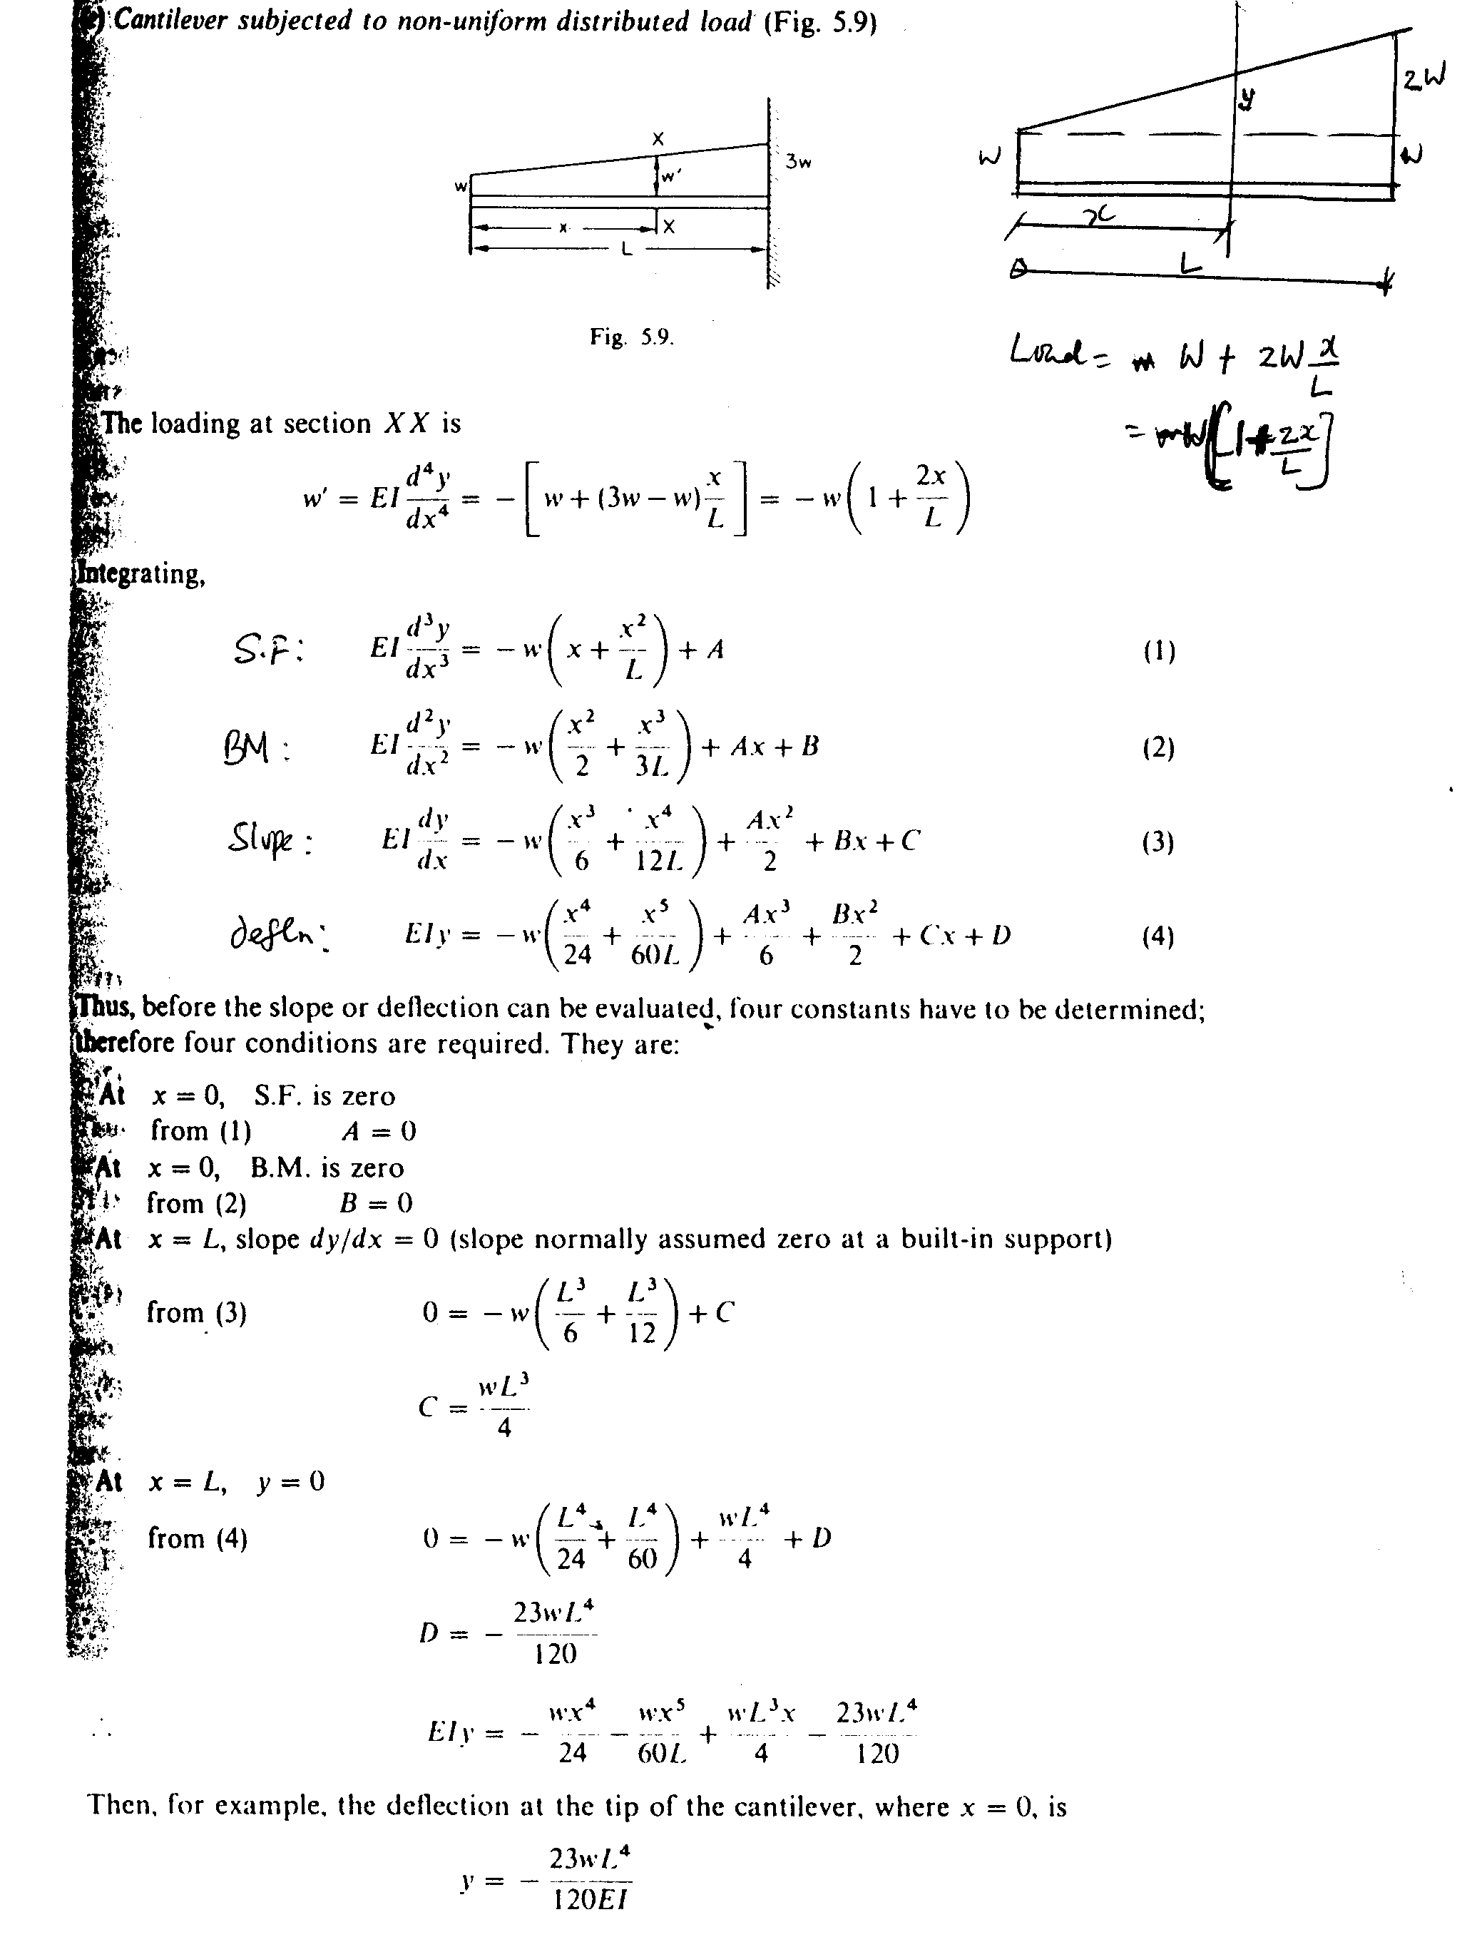

Slide 14
Macaulay’s Method
The Macaulay’s method involves the general method of obtaining slopes and deflections (i.e. integrating the equation for M) will still apply provided that the term, W (x – a) is integrated with respect to (x – a) and not x.

Slide 15
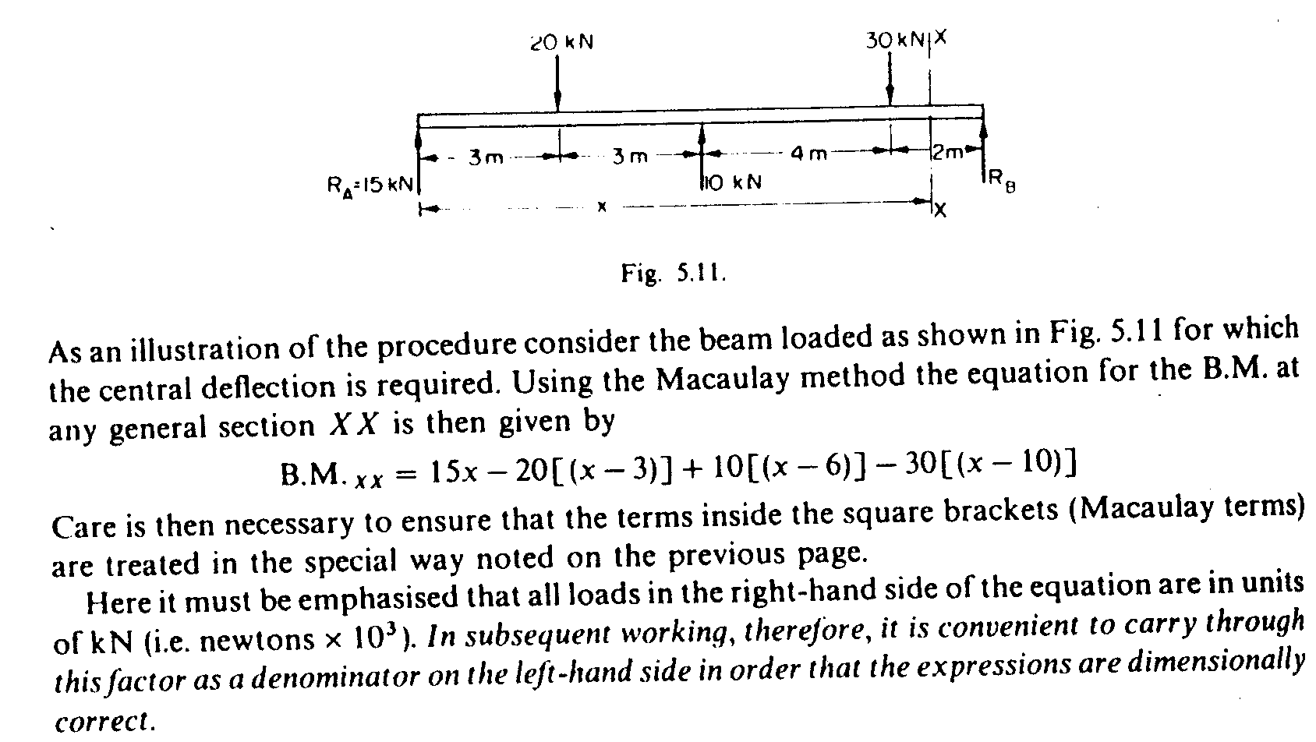
Example of Using Macaulay’s Method for Concentrated loads

Slide 16
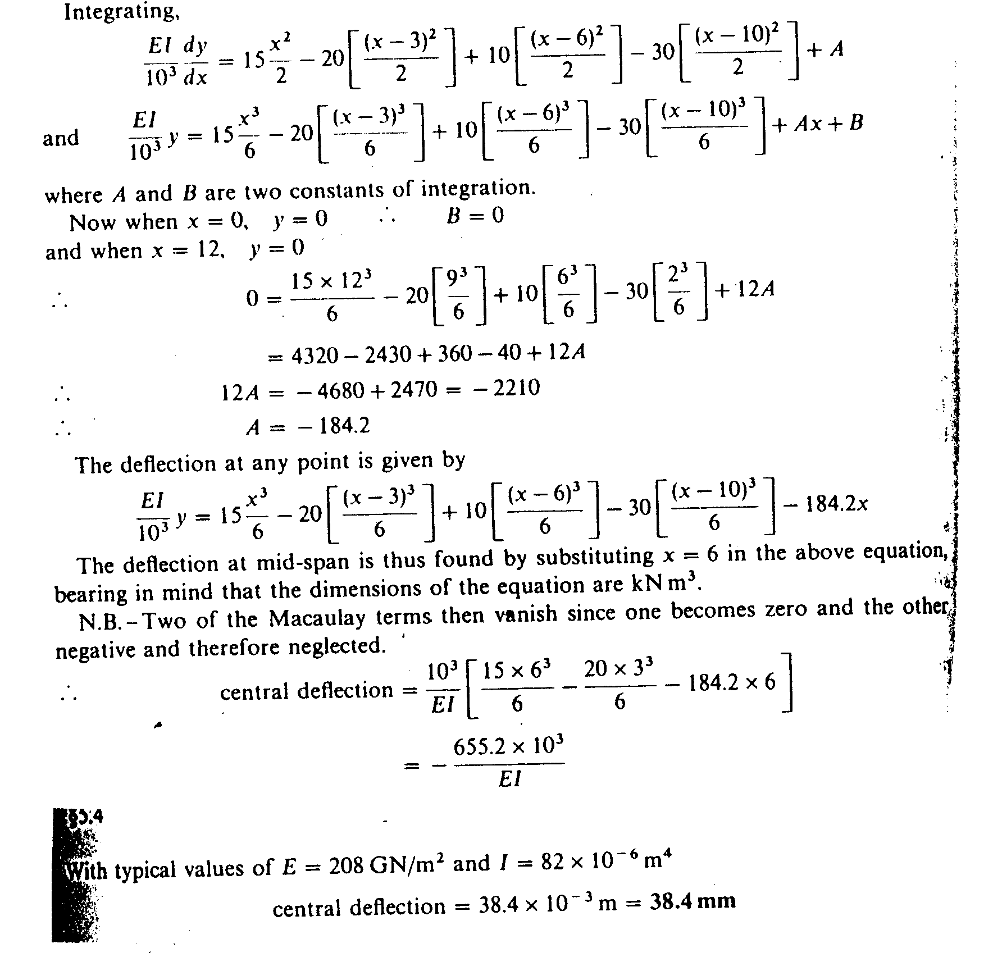
Example Contd.

Slide 17
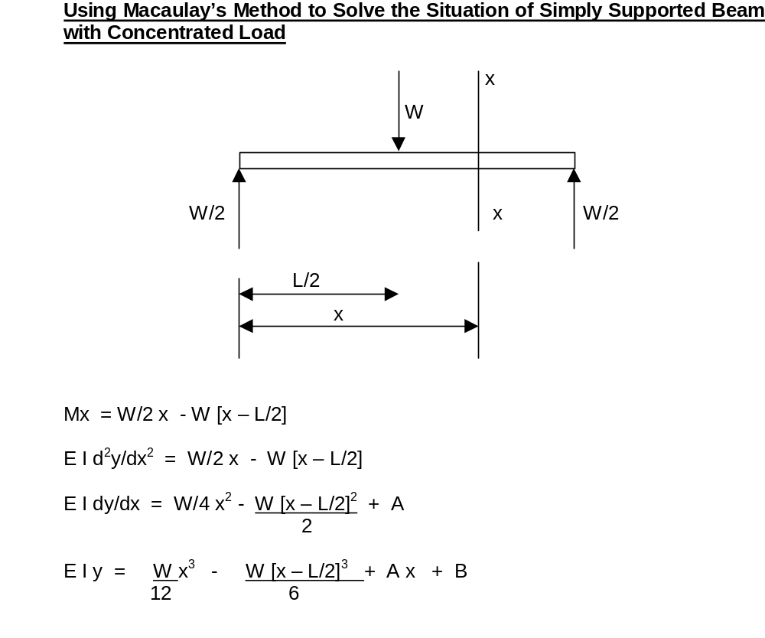

Slide 18
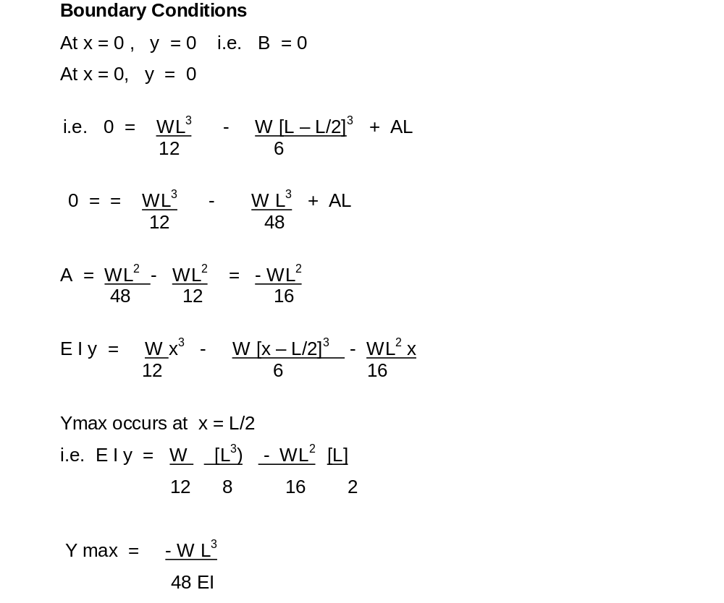

Slide 19
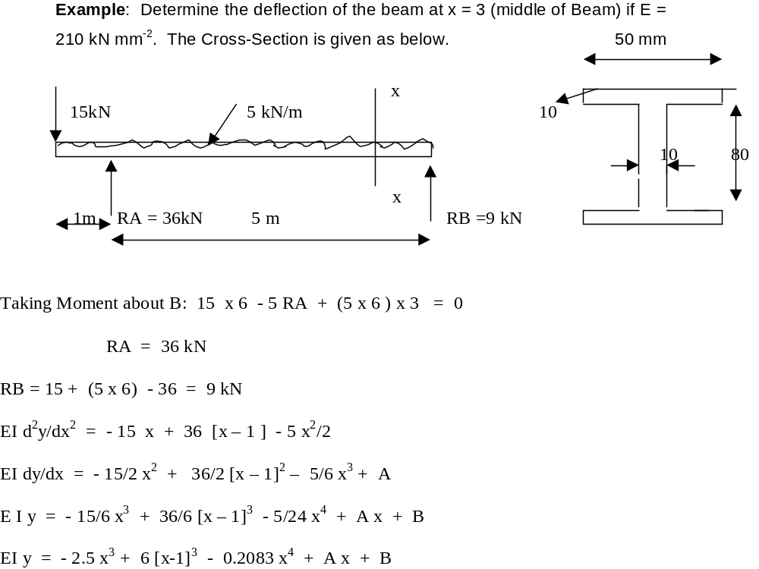
Macaulay’s Method for u.d.l.s

Slide 20
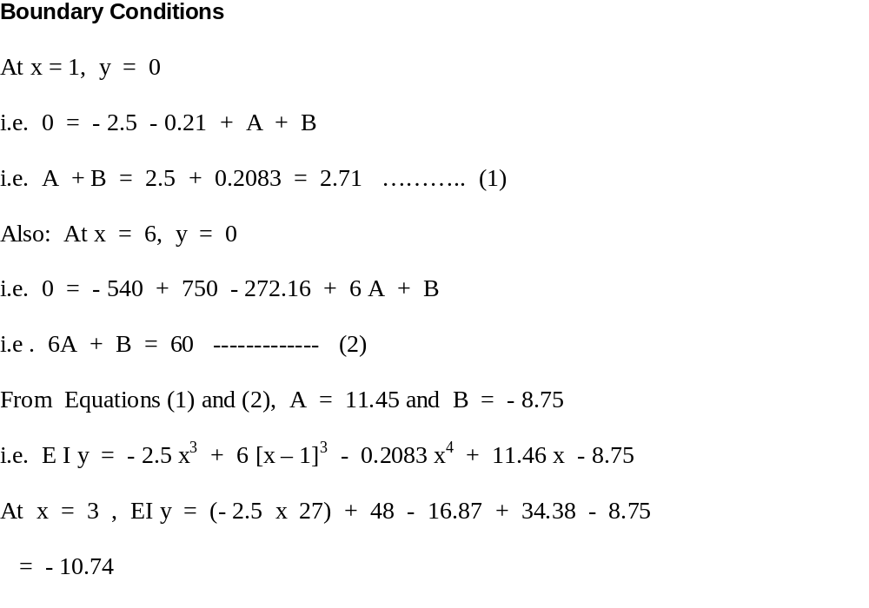

Slide 21
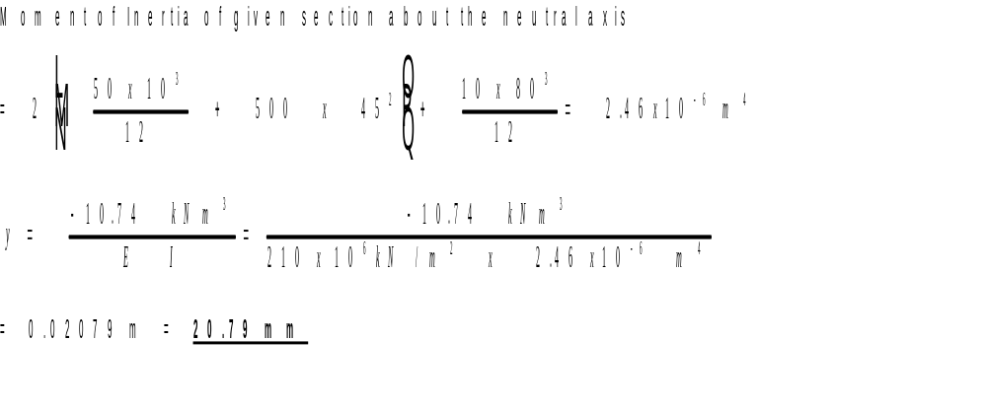
Solution Concluded

Slide 22
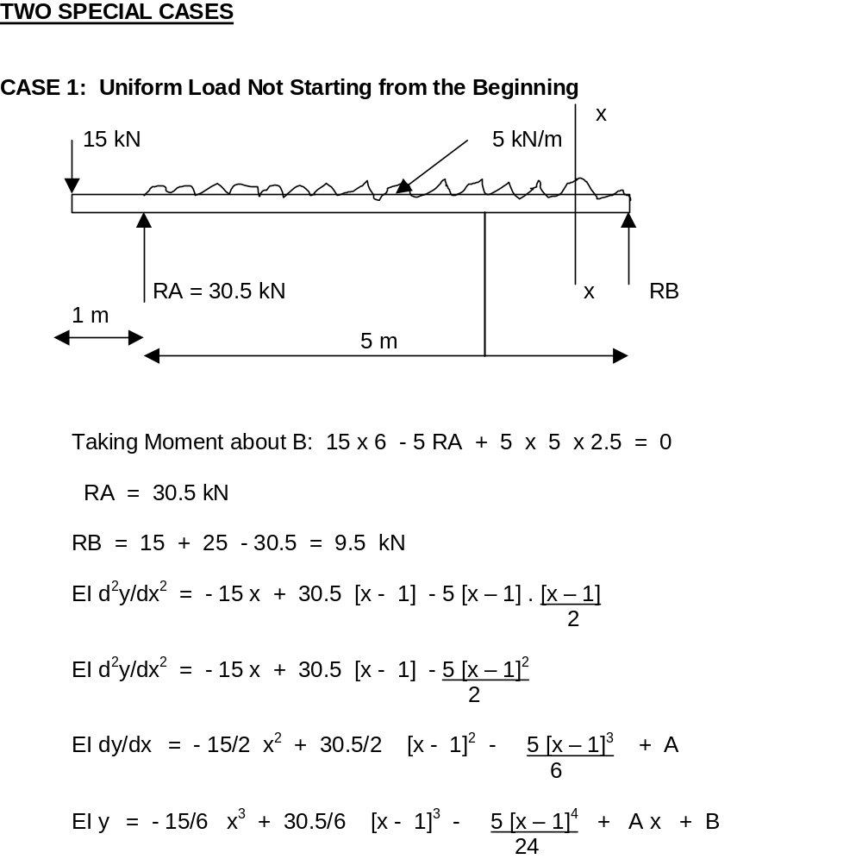
Two Special Cases

Slide 23
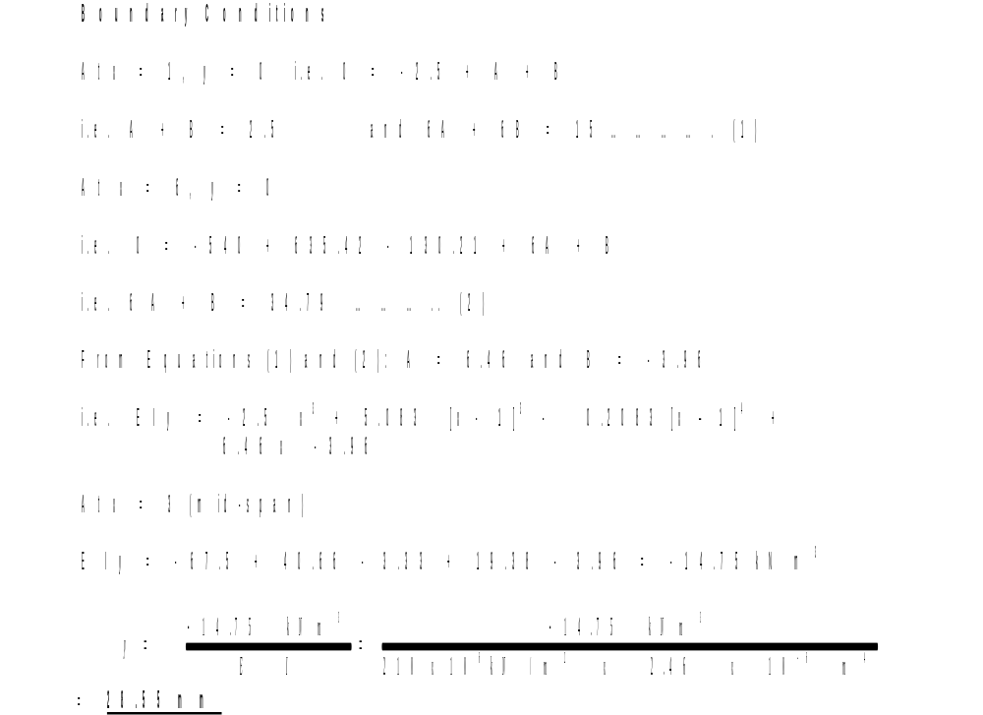
Solution of Case 1 Concluded

Slide 24
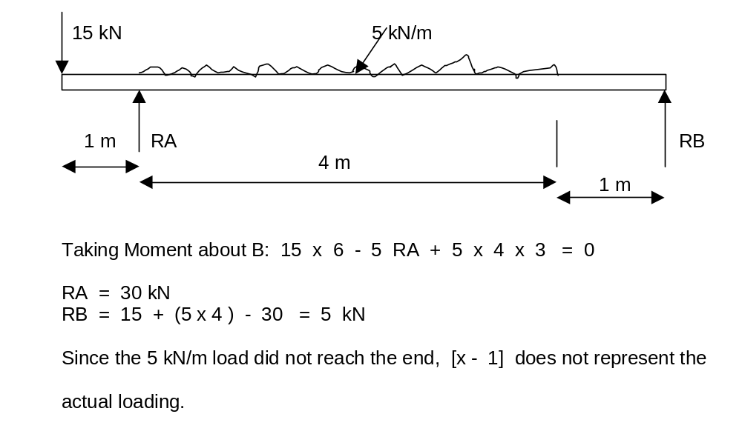
Case 2: Uniform Load Not reaching End of Beam

Slide 25
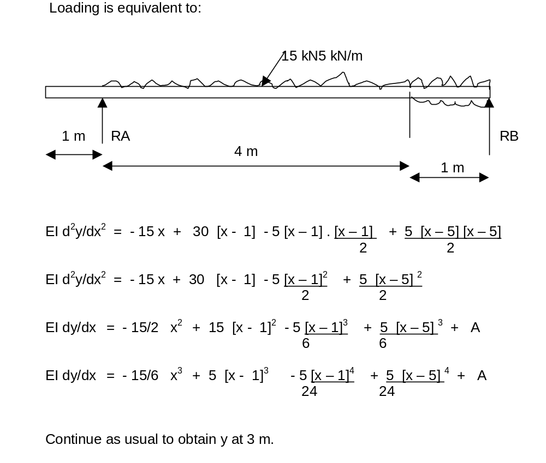
Solution to Case 2 Contd.

Slide 26
Mohr’s Area-Moment Method
The Mohr area-moment procedure can be summarised as:
If A and B are two points on the deflection curve of a beam, EI is constant and B is a point of zero slope, then the Mohr’s theorems state that:
(1) Slope at A = 1/EI x area of B.M. diagram between A and B
(2) Deflection at A relative to B = 1/EI x first moment of area of B.M diagram between A and B about A.

Slide 27
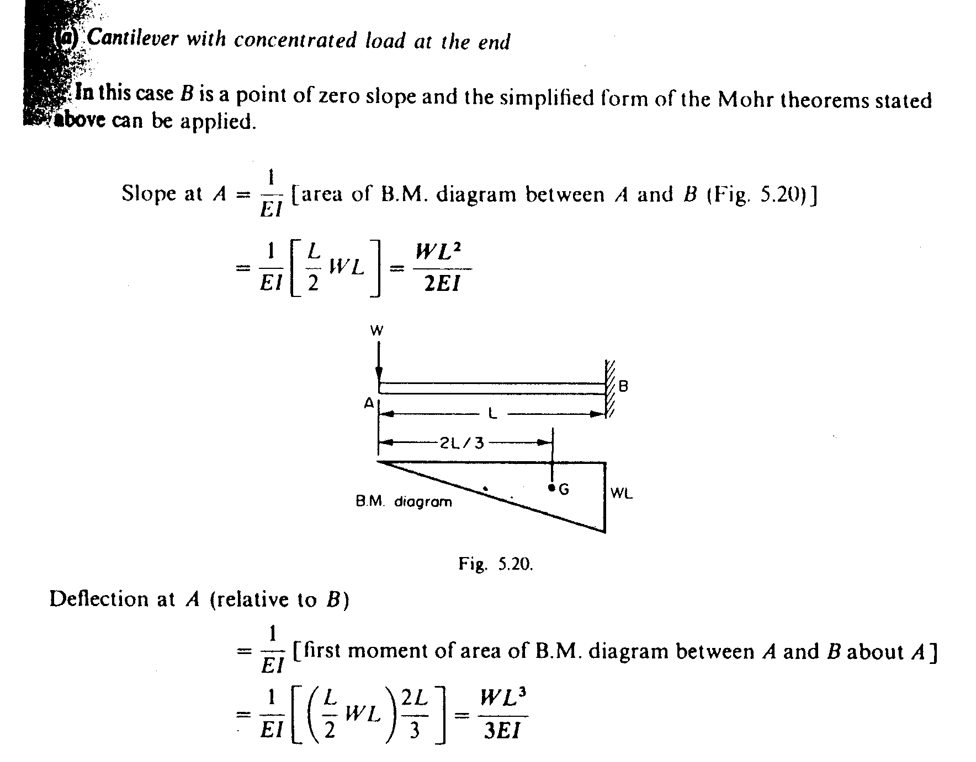

Slide 28
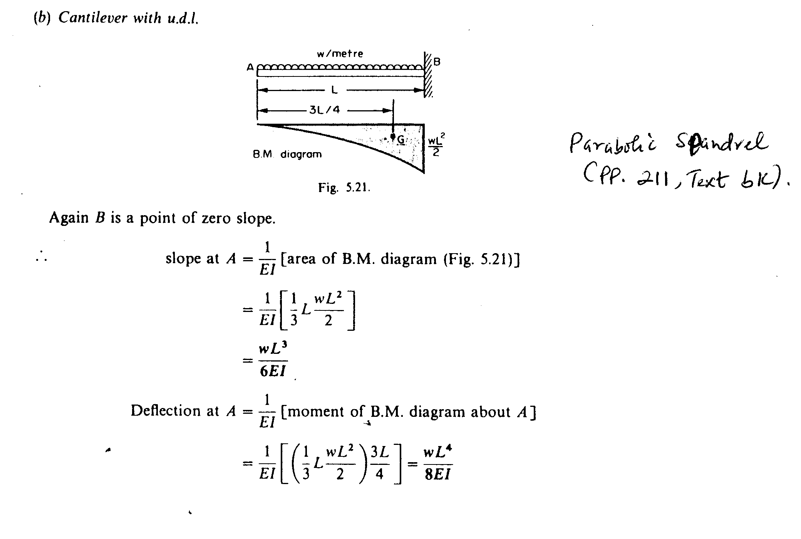

Slide 29
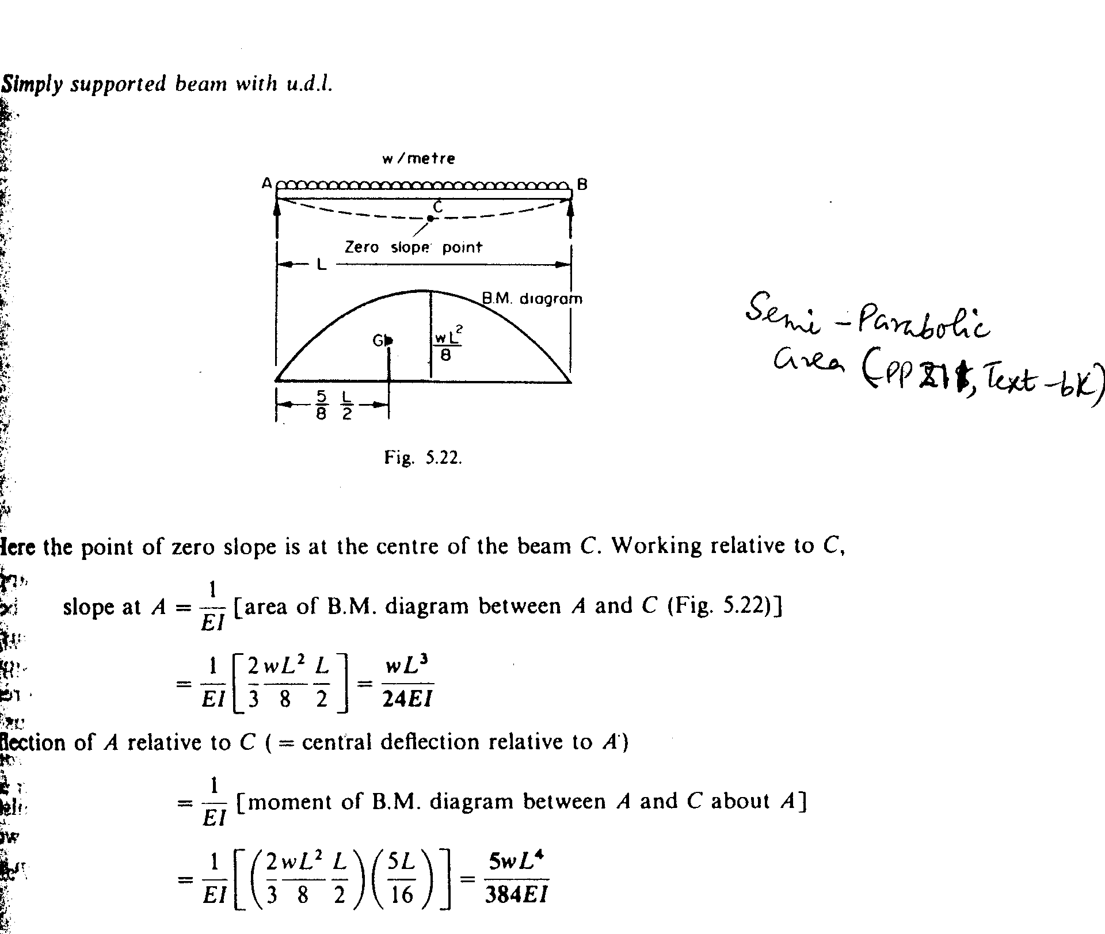

Slide 30
